Slide 1
Module 2

Slide 2
contents
Operators in C, Type conversion and typecasting.
Decision control and Looping statements:
Introduction to decision control,
Conditional branching statements,
iterative statements,
nested loops,
break and continue statements,
goto statement

Slide 3
Operators in C
An operator is a symbol that specifies the mathematical ,logical, or relational operation to be performed.
C language supports different types of operators.
It is used with variables and constants to form expressions
These operators can be categorized into the following major groups
Arithmetic operators
Relational operators
Equality operators
Logical operators
Unary operators
Conditional operators
Bitwise operators
Assignment operators
Comma operators
Sizeof operators

Slide 4
Arithmetic operators
Consider 3 variables declared as,
int a=9,b=3,result;
We will use these variables to explain Arithmetic operators.
It can be applied to any integer or floating point number.
%can be applied only to integers.
while performing modulo division, sign of result is always the sign of 1st operand. E.g.: -12%3=-1

Slide 5
Relational operators(Comparison operators)
its an operator that compare 2 values
Expression that contain relational operators are called relational expressions.
It return Boolean values
Its used to determine the relationships between the operands
These are evaluated from left to right

Slide 6
Equality operators
C supports 2 kind of equality operators to compare their operands for equality or inequality
1. equal to(==) 2. not equal to(!=) operators
Equality operators have lower precedence than relational operators

Slide 7
Logical operators
C supports 3 logical operators – logical AND, logical OR, logical NOT
Evaluated from left to right
1.Logical AND(&&)
It’s a binary operator , which evaluates 2 relational expressions or 2 values
For example: (a<b) &&(b>c)
2.. Logical OR(| |)
It returns a false value if both the operands are false, otherwise returns a true value
example: (a<b)||(b>c)
3.Logical NOT
It takes a single expression and reverses the value of expression

Slide 8
Logical operators
Example: int a = 10, b;
b = !a;

Slide 9
Unary operators
It acts on single operand . C supports 3 unary operators
1)Unary minus, 2)increment and 3)decrement operators
1)Unary minus:When operand is preceded by a minus sign, the unary operator negates its value.
Eg: int a, b=10;
a= -(b);
The result of this expression is a=-10 bcz variable b has +ve value. After applying unary minus operator on operand b, the value becomes -10(ie -ve value)
Increment(++) and decrement(--) operator:
++ increases value of its operand by 1, -- decreases value of its operand by 1
Increment and decrement operators have 2 variants., prefix and postfix

Slide 10
Conditional operators
Conditional or ternary(?:) is just like an if else statement that can be used within expressions
Its useful when there are 2 or more alternatives for an expression
Syntax of conditional operator is
  exp1 ? exp2 : exp3
  Here exp1 is evaluated first,if it is true ,then exp2 is evaluated and becomes the result of the expression, otherwise exp3 is evaluated and becomes the result of the expression
  Example: large = (a>b) ? a : b
  First a> b is evaluated,if a > b then large = a else large = b

Slide 11
Bitwise operators
Operators that performs operations at bit level
These operators include 1)bitwise AND 2)bitwise OR 3)bitwise XOR 4)Shift operators
1)bitwise AND: like Boolean AND bitwise AND operator performs operation on bits instead of bytes, chars,integers etc
2)bitwise OR: when we use this operator ,the bit in first operand is ORed with corresponding bit in 2nd operand
3)bitwise XOR:It perform operation on individual bits of operands.
EXAMPLE: int a=10, b=20 , c=0;
C= a&b; c=a|b; c= a^b;

Slide 12
Bitwise operators
Shift operators:
C supports 2 shift operators 1)shift-left 2)shift-right
Its simple and are responsible for shifting bits either to the left or to the right
Syntax: operand op num
Example: x << 1 produces 0011 1010

Slide 13
Assignment operators
Its responsible for assigning values to the variable
Example: int x;
x = 10;
Comma operator: it takes 2 operands
Example int a = 2. b=3, x=0;
x=(++a, b+=a);
x=6
Sizeof operators:
Example: int a=10;
unsigned int result;
result = sizeof(a);
size of a is 2 .since a is an integer it requires 2 bytes of storage in memory

Slide 14
Type conversion and typecasting.
Type conversion or typecasting of variables refers to changing a variables of one data types into another
Type conversion is done implicitly whereas typecasting has to be done explicitly by programmer
Type conversion:
Its done when the expressions has variables of different data types
To evaluate the expression, the data type is promoted from lower to higher level where the hierarchy of data types (from higher to lower) can be given as: double, float, long, int, short, and char.
Figure 9.14 shows the conversion hierarchy of data types.
Type conversion is automatically done when we assign an integer value to a floating point variable.
Consider the code given below in which an integer data type is promoted to float. This is known as promotion (when a lower level data type is promoted to a higher type).

Slide 15
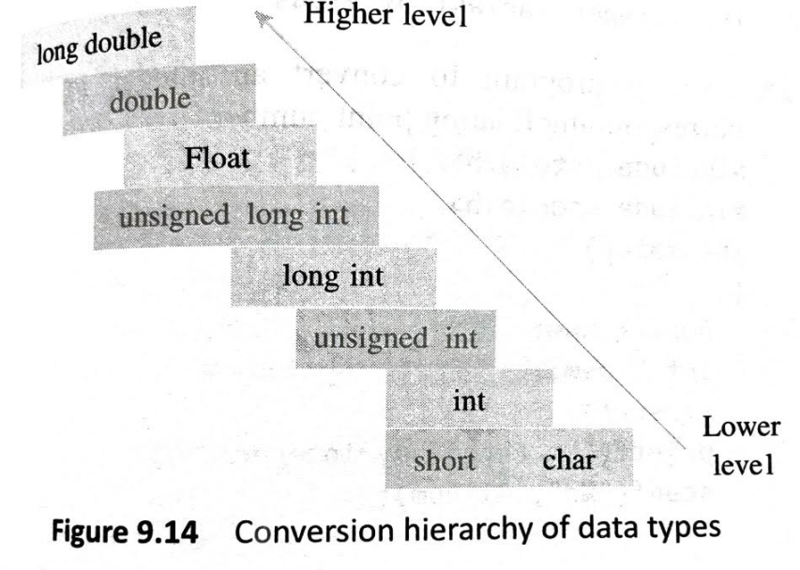
Type conversion and typecasting.
consider the following group of statements:
float f= 3.5;
int i;
i = f:
The statement i = f results in f to be demoted to type int, i.e., the fractional part of f will be lost and i will contain 3 (not 3.5). In this case demotion takes place, i.e., a higher level data type is converted into a lower type.
Whenever demotion occurs, some information is lost. For example, in this case the fractional part of the floating point number is lost
Example : float x;
      int y = 3;
      x = y;

Slide 16
Type conversion and typecasting.
TypeCasting
Typecasting is also known as forced conversion.
Typecasting an arithmetic expression tells the compiler to represent the value of the expression in a certain way.
It is done when the value of a higher data type has to be converted into the value of a lower data type. But this casting is under the programmer's control and not under compiler's control.
For example, if we need to explicitly typecast a floating point variable into an integer variable, then the code to perform typecasting can be given as:
Example: float salary = 10000.00;
int sal;
sal = (int) salary;

Slide 17
Type conversion and typecasting.
When floating point numbers are converted to integers (as in type conversion), the digits after the decimal are truncated. Therefore, data is lost when floating-point representations are converted to integral representations.
So in order to avoid such type of inaccuracies, int type variables must be typecast to float type.
As we see in the code above, typecasting can be done by placing the destination data type in parentheses followed by the variable name that has to be converted.
Hence, we conclude that typecasting is done to make a variable of one data type to act like a variable of another type.

Slide 18
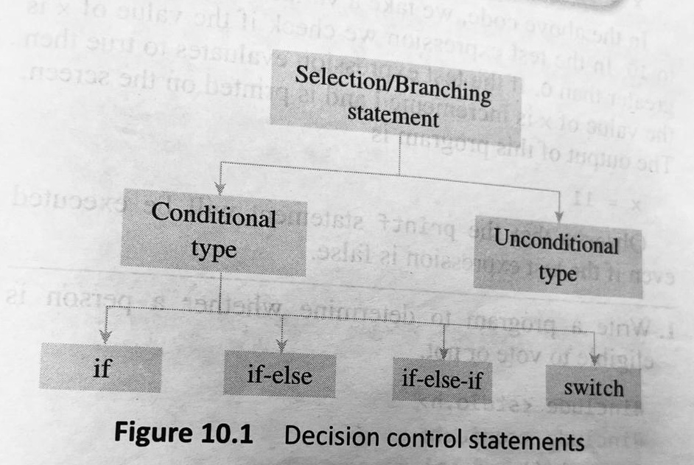
Decision control and Looping statements:
C supports 2 types of decision control statements
1. Conditional type branching
2. unconditional type branching
In the case of decision control statements in C language (nested if and if-else), a group of available statements will get executed in case the conditions we have are true.

Slide 19
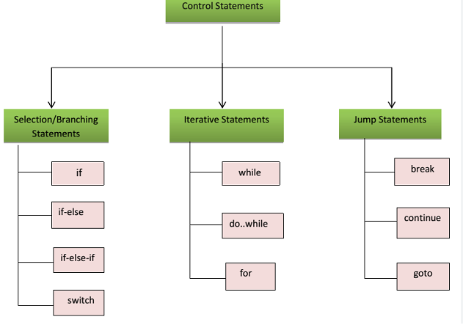

Slide 20
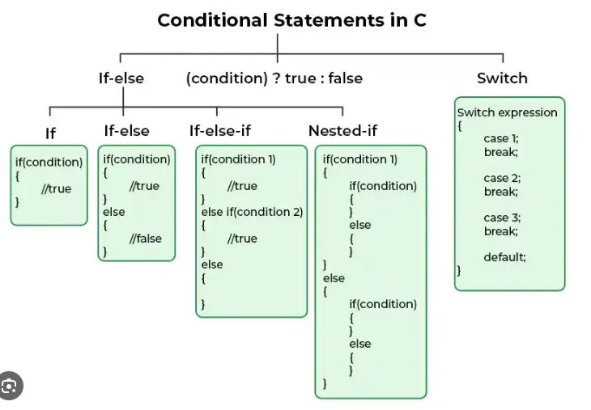
Conditional branching statements
This statements help to jump from one part of the program to another depending on whether a particular condition is satisfied or not. These include
1. if statement
2. if-else statement
3.if-else-if statement
4. switch statement

Slide 21
1. if statement
The if statement is the simplest form of decision control statements that is frequently used in decision-making.
The if block may include one statement or n statements enclosed within curly brackets.
First, the test expression is evaluated. If the test expression is true, the statement of if block (statement 1 to n) are executed otherwise these statements will be skipped and the execution will jump to statement x.
The statement in an if block is any valid C language statement
the test expression is any valid C language expression that may include logical operators.
The general form of a simple if statement is shown in Figure 10.2.

Slide 22
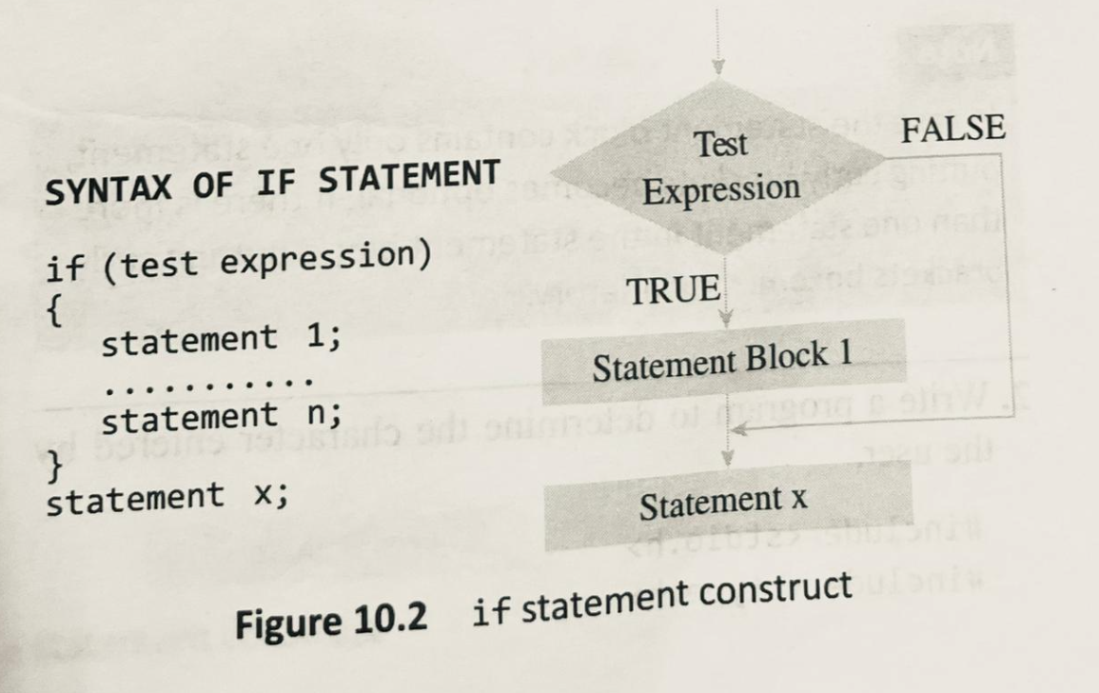
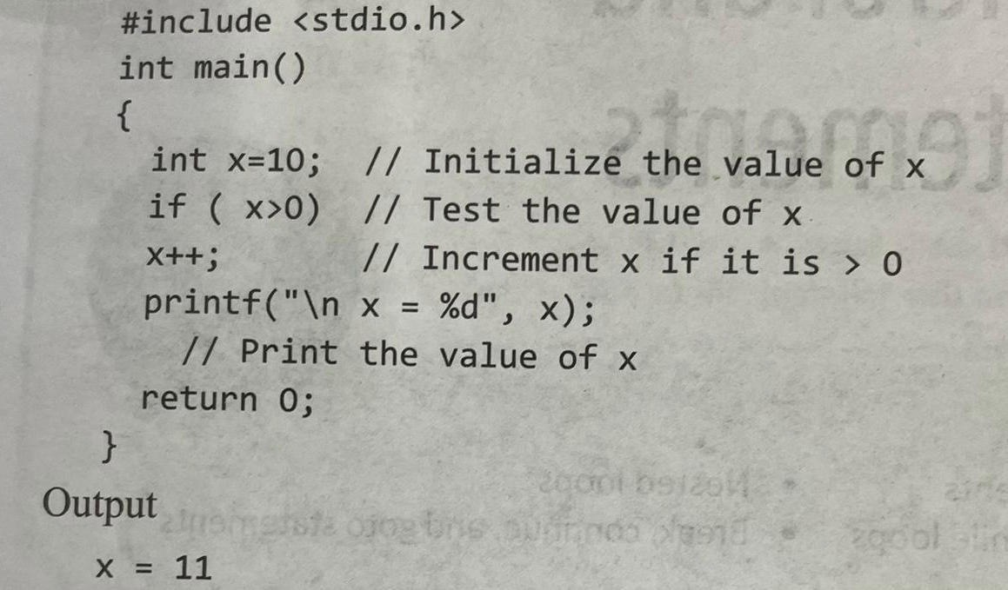

Slide 23
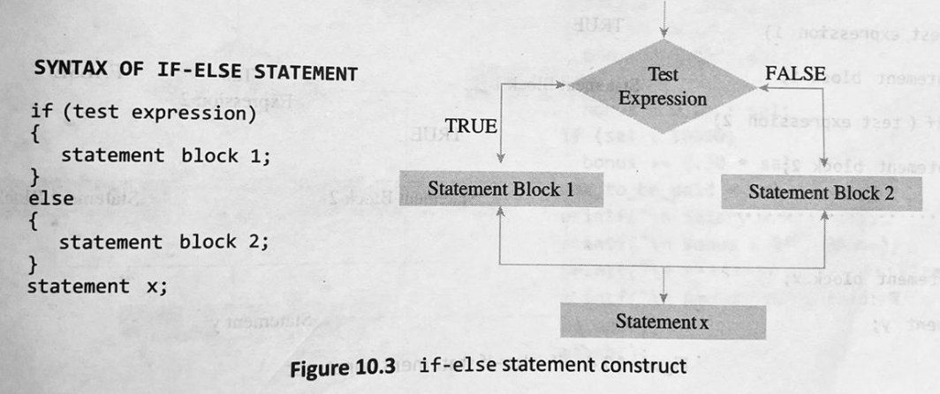
2. if-else statement
Its usage is very simple.
The test expression is evaluated. If the result is true, the statements followed by the expression is executed else if the expression is false, the statement in else part will be executed.
The general form of a simple if-else statement is shown in Figure 10.3.
In the syntax shown, we have written statement block.
A statement block may include one or more statements.
According to the if-else construct, first the test expression is evaluated. If the expression is true, statement block 1 is executed and statement block 2 is skipped.
Otherwise, if the expression is false, statement block 2 is executed and statement block 1 is ignored.

Slide 24
3.if-else-if statement
The if-else-if construct works in the same way as a normal if statement and if else statement.
if-else-if construct is also known as nested if construct.
Its construct is given in Figure 10.4.
It is not necessary that every if statement should have an else block as c supports simple if statements.
After the first test expression or the first if branch, the programmer can have as many else-if branches as he wants depending on the expressions that have to be tested.

Slide 25
Rules for using if, if-else, and if-else-if statement
Rule 1: The expression must be enclosed in parentheses.
Rule 2: No semicolon is placed after the if/if-else/ if-else-if statement. Semicolon is placed only at the end of statements in the statement block.
Rule 3: A statement block begins and ends with a curly brace. No semicolon is placed after the opening/closing braces.

Slide 26
Dangling Else Problem
With nesting of if-else statements, we often encounter a problem known as dangling else problem.
This problem is created when there is no matching else for every if statement.
In such cases, C always pairs an else statement to the most recent unpaired if statement in the current block.
Consider the following code which shows such a scenario.
if(a > b)
if(a > c)
printf("In a is greater than b and c");
else
printf("In a is not greater than b and c");
The problem is that both the outer if statement and the inner if statement might conceivably own the else

Slide 27
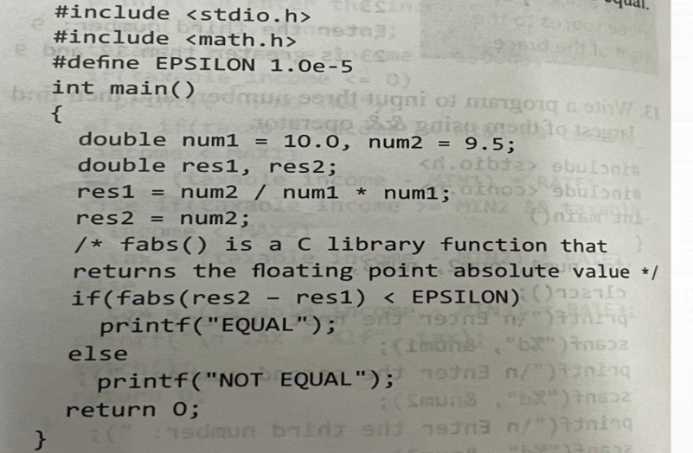
Comparing Floating Point Numbers
We should never use floating point it numbers for testing quality.
This is because floating point numbers are just approximations, so it is always better to use floating point numbers for testing
We can test for approximate equality by subtracting the two floating point numbers (that are to be tested) and comparing their absolute value of the difference against a very small number, epsilon.
For example, consider the code given below which compares two floating point numbers Note that epsilon is chosen by the programmer to be small enough so that the two numbers can be considered equal.

Slide 28
4. switch statement
A switch case statement is a multi-way decision statement that is a simplified version of an if-else block that evaluates only one variable.
The general form of a switch statements shown in Figure 10.5.
It is mostly used in 2 situations
1.when there is only one variable to evaluate in the expression
2.when many conditions are being tested for
Default case is executed when no match is found between values of switch and case statements and thus there are no statements to executed.

Slide 29
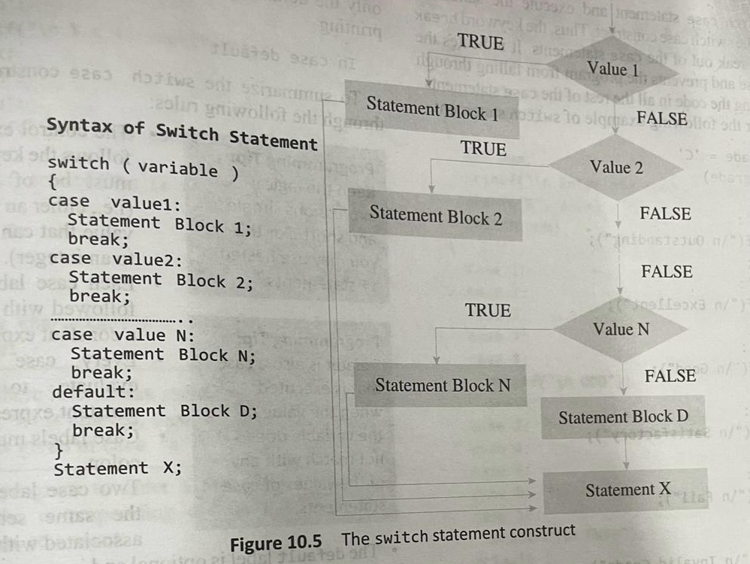
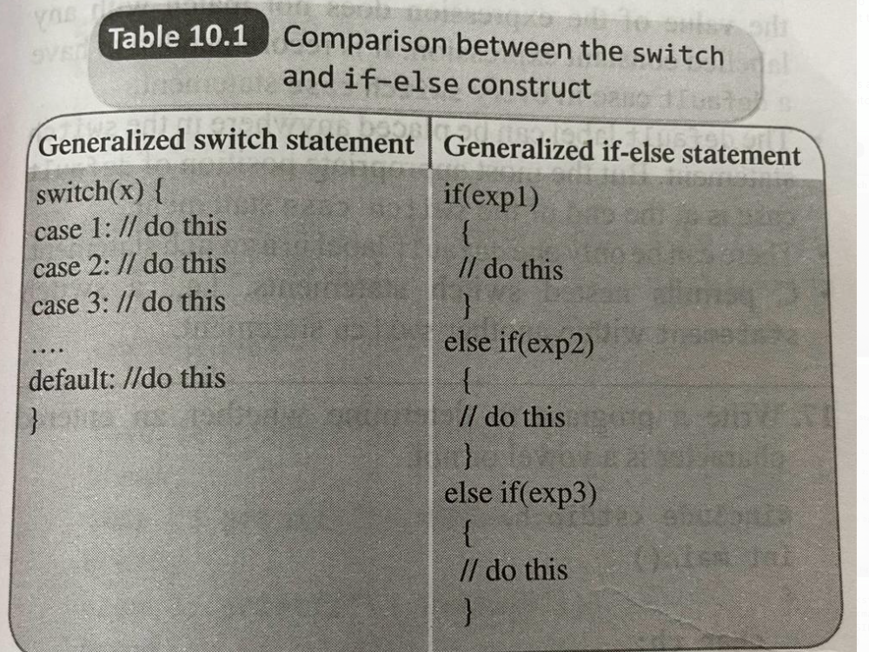

Slide 30
Iterative statement
Iterative statements are used to repeat the execution of a list of statements, depending on the value of an integer expression.
C language supports three types of iterative statements also known as looping statements.
They are:
• while loop
• do-while loop
• for loop

Slide 31
while loop
The while loop provides a mechanism to repeat one or more statements while a particular condition is true.
Figure 10.6 shows the syntax and general form of representation of a while loop.
In the while loop, the condition is tested before any of the statements in the statement block is executed.
If the condition is true, only then the statements will be executed otherwise if the condition is false, the control will jump to statement y, which is the immediate statement outside the while loop block.
For example look at the following code which print first 10 numbers using while loop

Slide 32
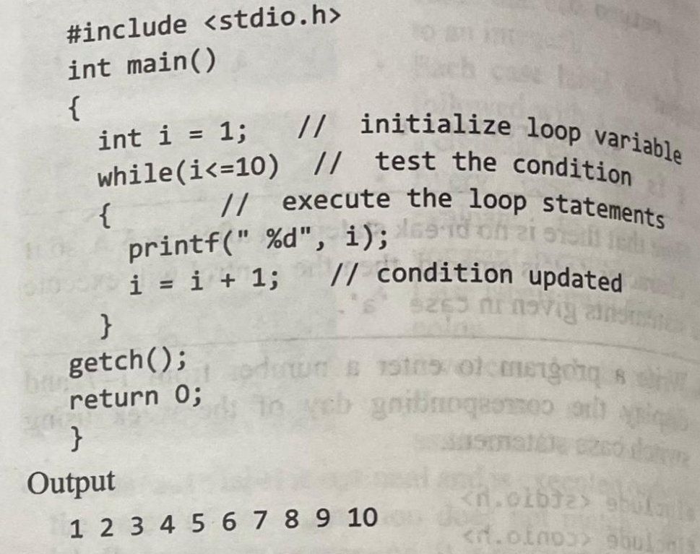
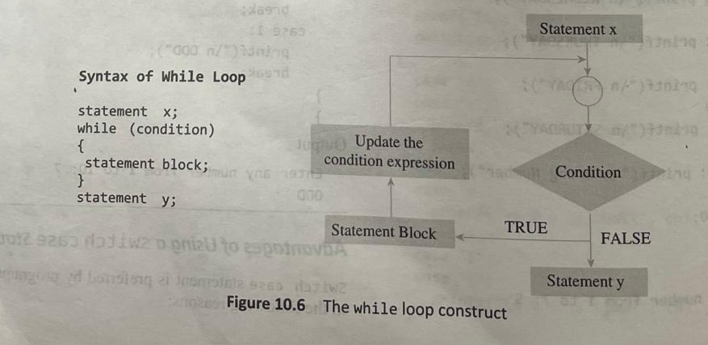
while loop

Slide 33
Do-while loop
The do-while loop is similar to the while loop.
The only difference is that in a do-while loop, the test condition is evaluted at the end of the loop.
Now that the test condition is evaluted at the end, this clearly means that the body of the loop gets executed at least one time (even if the condition is false).
Figure 10.7 shows the syntax and general form of representation of a do-while loop.
Note that the test condition is enclosed in parentheses and followed by a semicolon.
The statements in the statement block are enclosed within curly brackets.
The curly brackets are optional if there is only one statement in the body of the do-while loop.
Like the while loop, the do-while loop continues to execute whilst the condition is true.

Slide 34
Do-while loop
There is no choice whether to enter the loop or not because the loop will be executed at least once irrespective of whether the condition is true or false.
Hence, entry in the loop is automatic.
There is only one choice: to continue or to exit. The do-while loop will continue to execute while the condition is true and when the condition becomes false, the control will jump to statement following the do-while loop.
Similar to the while loop, the do-while is an indefinite loop as the loop can execute until the user wants to stop.
The number of times the loop has to be executed can thus be determined at the run time.
However, unlike the while loop, the do-while loop is a bottom-checking loop, since the control expression is placed after the body of the loop.
The major disadvantage of using a do-while loop is that it always executes at least once, even if the user enters

Slide 35
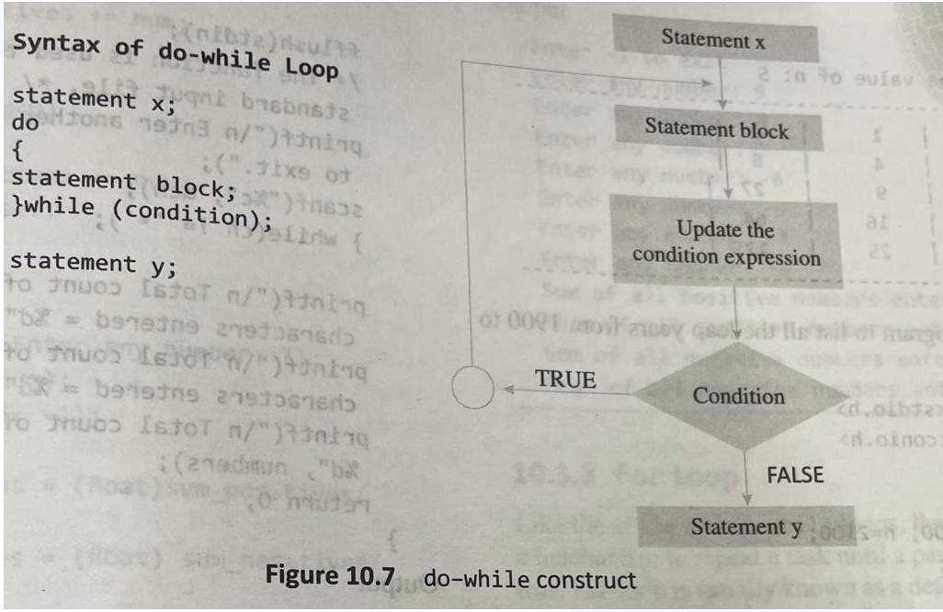
Do-while loop

Slide 36
For loop
Like the while and do-while loops, the for loop provides a mechanism to repeat a task until a particular condition is true.
Its also known as a determinate or definite loop because the programmer knows exactly how many times the loop will repeat.
The syntax and general form of a for loop is given in Figure 10.8.
When a for loop is used, the loop variable is initialized only once. With every iteration of the loop, the value of the loop variable is updated and the condition is checked.
If the condition is true, then the statement block of the loop is executed, else the statements comprising the statement block of the for loop are skipped and the control jumps to the immediate statement following the for loop body.

Slide 37
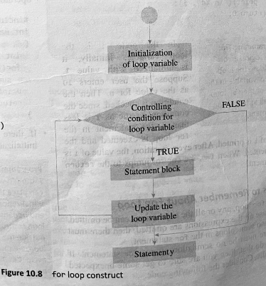
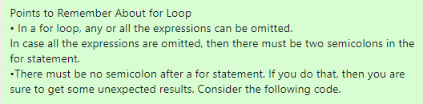
For loop
The for loop is widely used to execute a single or a group of statements a limited number of times.
Multiple statements can be included in the third part of the for statement by using the comma operator. For example, the for statement given below is valid in C.
for (1=0, j=10;i<j; i++, j- -)

Slide 38
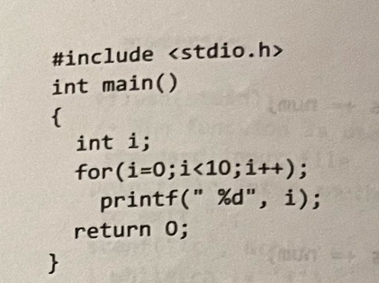
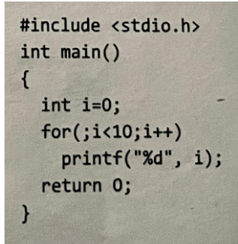
For loop
In this code, the loop initializes i to 0 and increments its value.
Since a semicolon is placed after the loop, It means that loop does not contain any statement.
So even if the condition is true, no statement is executed.
The loop continues till i becomes 10 and the moment i=10, the statement following the for loop is executed and the value of i (10) is printed on the screen.
If there is no initialization to be done, then initialization stmnt can be skipped by giving only semicolon

Slide 39
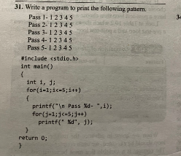
Nested loops
C allows its users to have nested loops, i.e., loops that can be placed inside other loops.
Although this feature will work with any loop such as while, do-while, and for, it is most commonly used with the for loop, because this is easiest to control.
A for loop can be used to control the number of times that a particular set of statements will be executed. Another outer loop could be used to control the number of times that a whole loop is repeated.

Slide 40
Jump statements
1.Break statement
2. continue statement
3. go to statement
1.Break statement
In C, the break statement is used to terminate the execution of the nearest enclosing loop in which it appears.
We have already seen its usage in the switch statement.
The break statement is widely used with for loop, while loop, and do-while loop.
When the compiler encounters a break statement, the control passes to the statement that follows the loop in which the break statement appears.

Slide 41
1.Break statement
Its syntax is quite simple, just type keyword break followed with a in which it is semicolon.break;
In switch statement if the break statement is missing then every case from the matched case label till the end of the switch, including the default, is executed.
This example given below shows the manner in which break statement is used to terminate the statement
Note that the code is meant to print first 10 numbers using a while loop, but it will actually print only numbers from 1 to 4.
As soon as i becomes equal to 5, the break statement is executed and the control jumps to the statement following the while loop.

Slide 42
Hence, the break statement is used to exit a loop from any point within its body, bypassing its normal termination expression.
When the break statement is encountered inside a loop, the loop is immediately terminated, and program control is passed to the next statement following the loop.
Figure 10.9 shows the transfer of control when the break statement is encountered

Slide 43
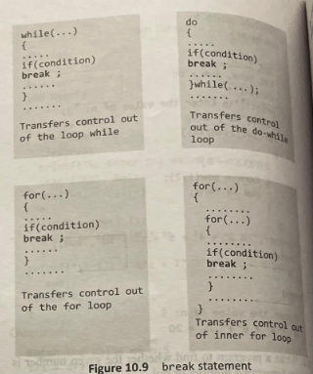

Slide 44
Continue statement
Like the break statement, the continue statement is used in the body of a loop.
When the compiler encounters a continue statement the rest of the statements in the loop are skipped and the control is unconditionally transferred to the loop continuation portion of the nearest enclosing loop.
Again like the break Statement, the continue statement cannot be used without an enclosing for , while ,or do-while statement.
When the continue statement is encountered in the while and do-while loops, the control is transferred to the code that tests the controlling expression.
However, if placed within a for loop, the continue statement causes a branch to the code that updates the loop variable. For example, look at the following code.

Slide 45
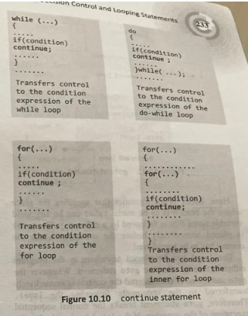

Slide 46
goto statement
The goto statement is used to transfer control to a specified label.
However, the label must reside in the same function and can appear only before one statement in the same function.
The syntax of goto statement is shown in Figure 10.11.
Here, label is an identifier that specifies the place where the branch is to be made.
Label can be any valid variable name that is followed by a colon (:).
The label is placed immediately before the statement where the control has to be transferred.
The label can be placed anywhere in the program either before or after the goto statement.

Slide 47
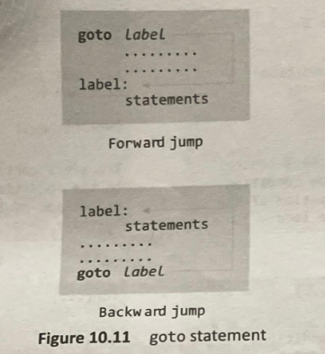
If the label is placed after the goto statement, then it is called a forward jump and in case it is located before the goto statement, it is said to be a backward jump.
IF condition THEN goto label

